Slide 1
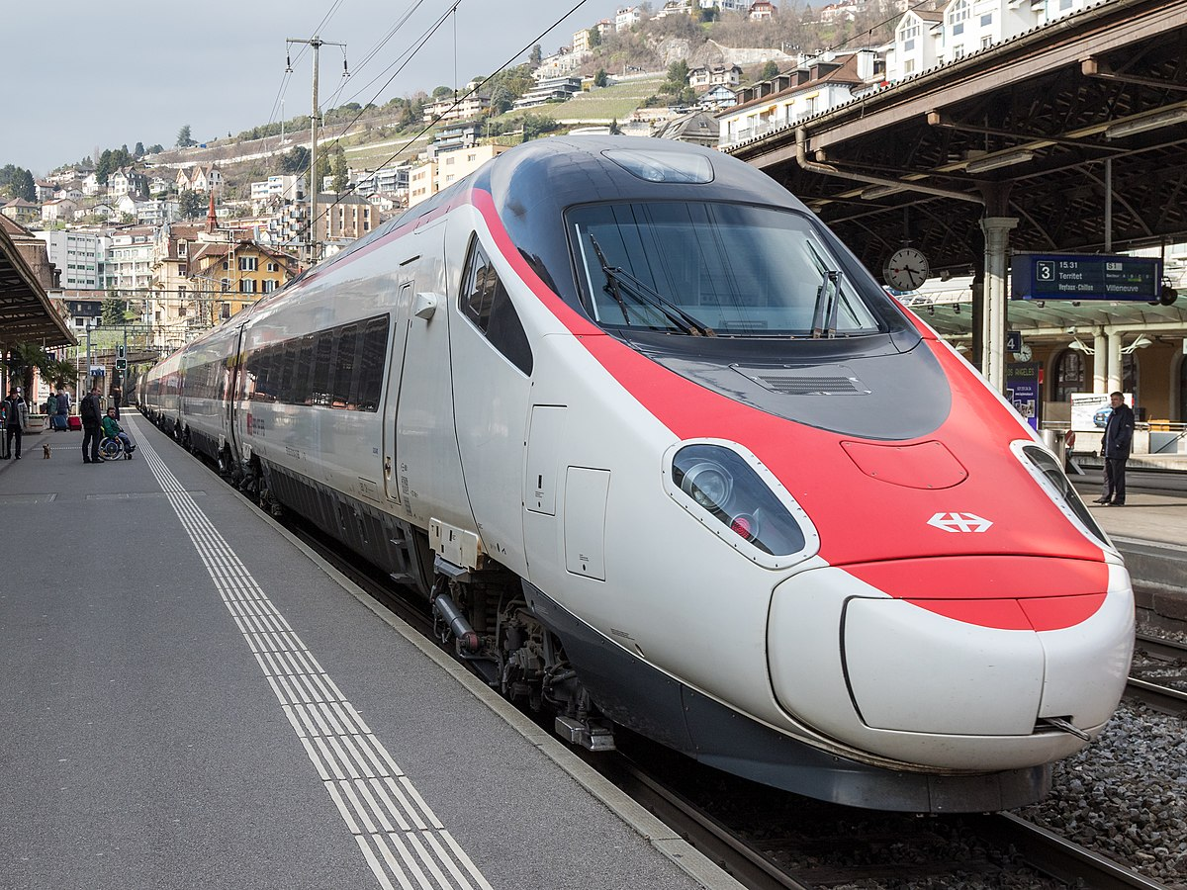
UK Train Rids
First Quarter 2024 Operational Review

Slide 2





Home
About Us
Service
Contact
TABLE OF CONTENTS
DATA COLLECTION
Explore Data
with Python
DATA CLEANING
Data visualization

Slide 3

TEAM MEMBERS
AHMED TAHA
AHMED SHERIF
ZIAD MOHAMED
REEM KHALED
ASEM KHALED
YOUSEF ELBEDAWY

Slide 4


DATA COLLECTION

Slide 5
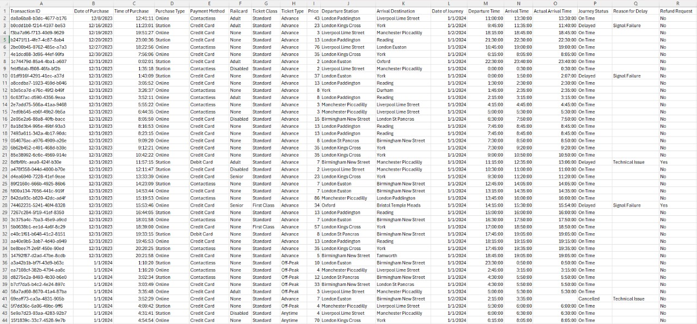

Slide 6



Explore Data with Python

Slide 7
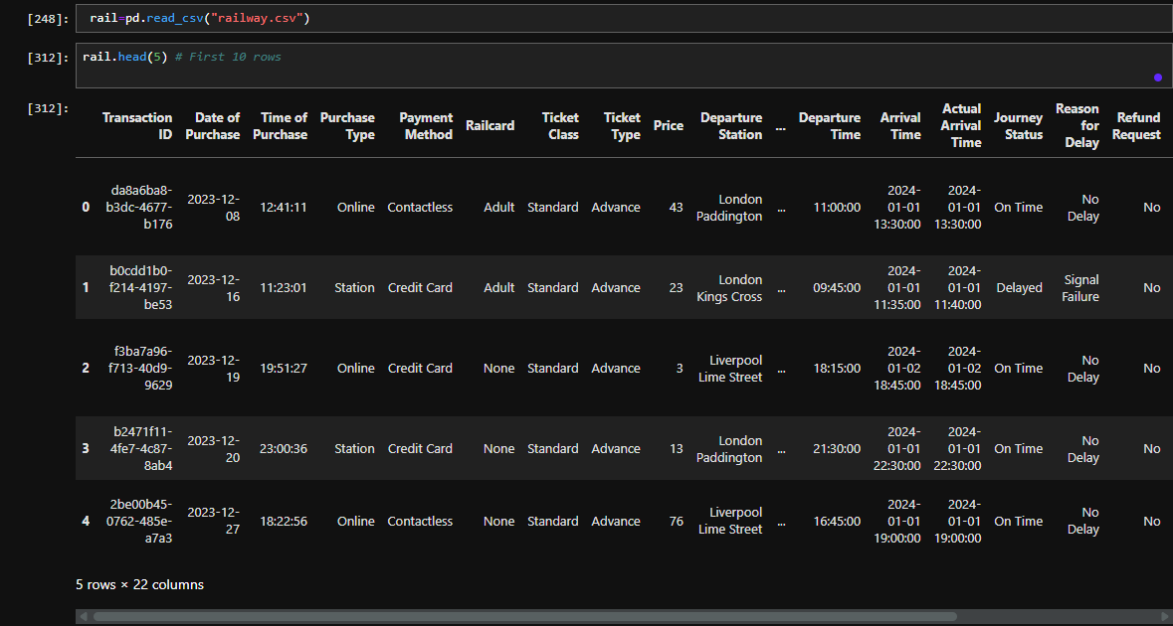
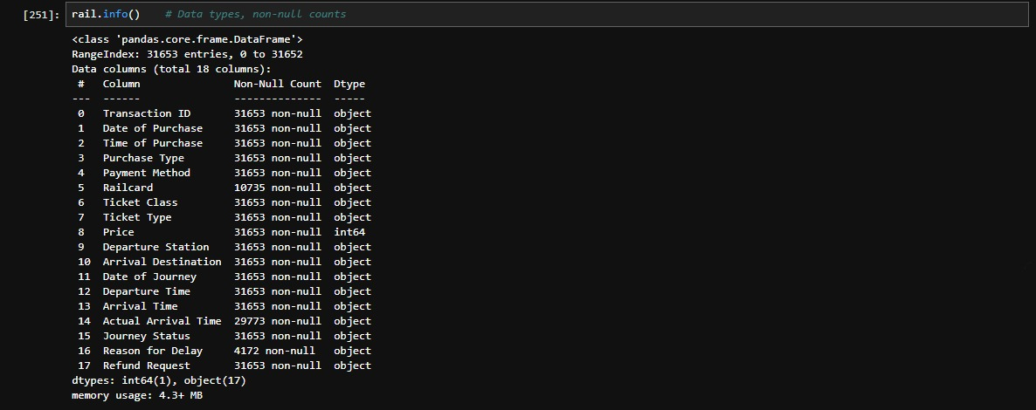

Slide 8
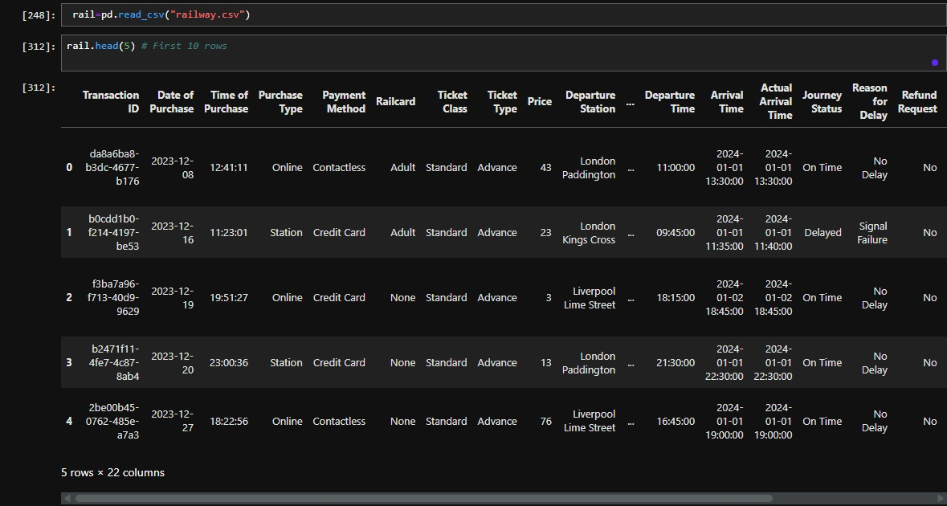

Slide 9

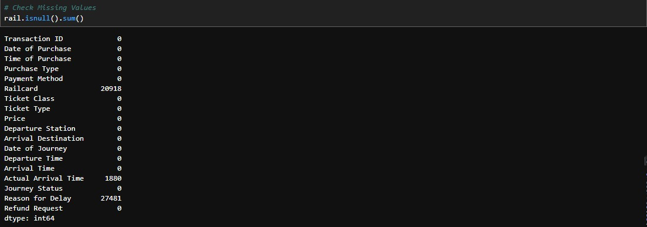
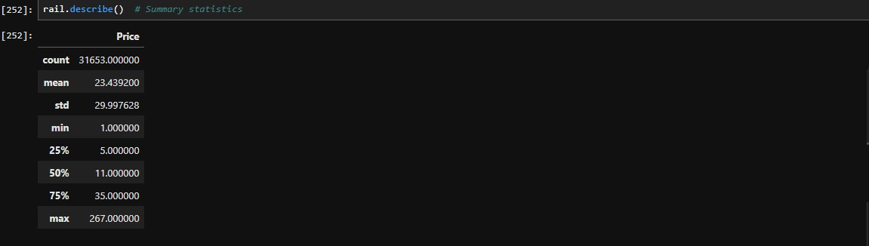

Slide 10
wrangling Data with Python

Slide 11
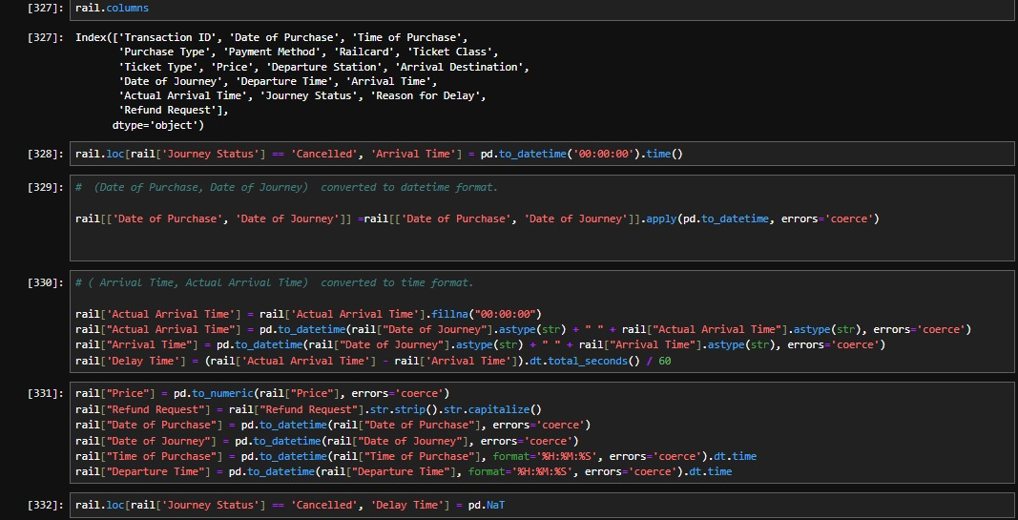

Slide 12
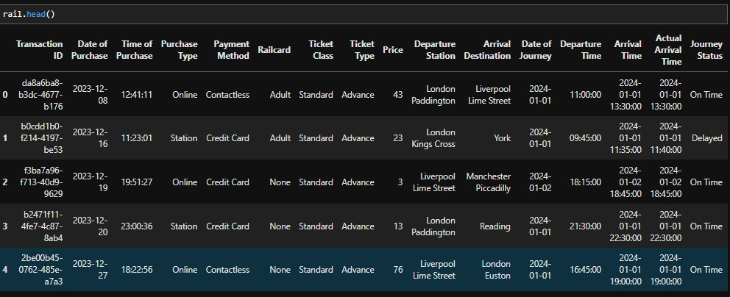

Slide 13
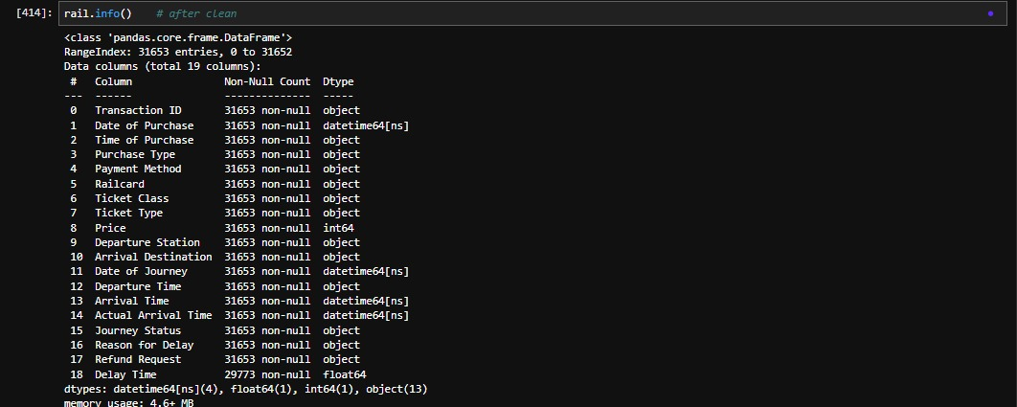

Slide 14
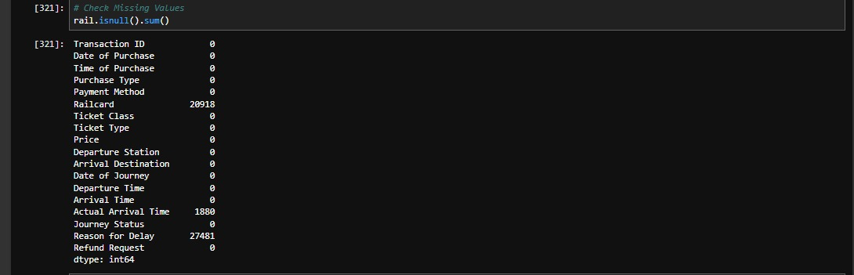
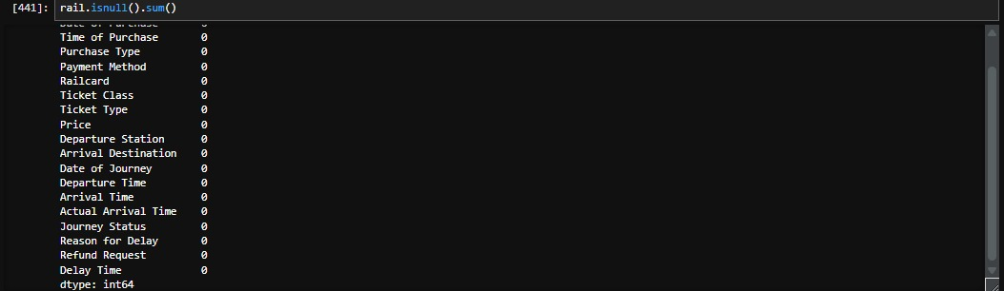

Slide 15
Build model .

Slide 16
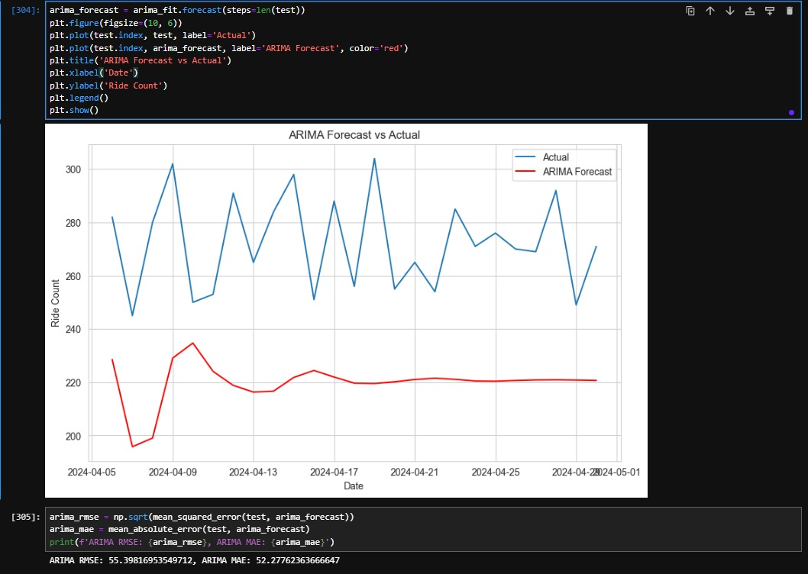

Slide 17
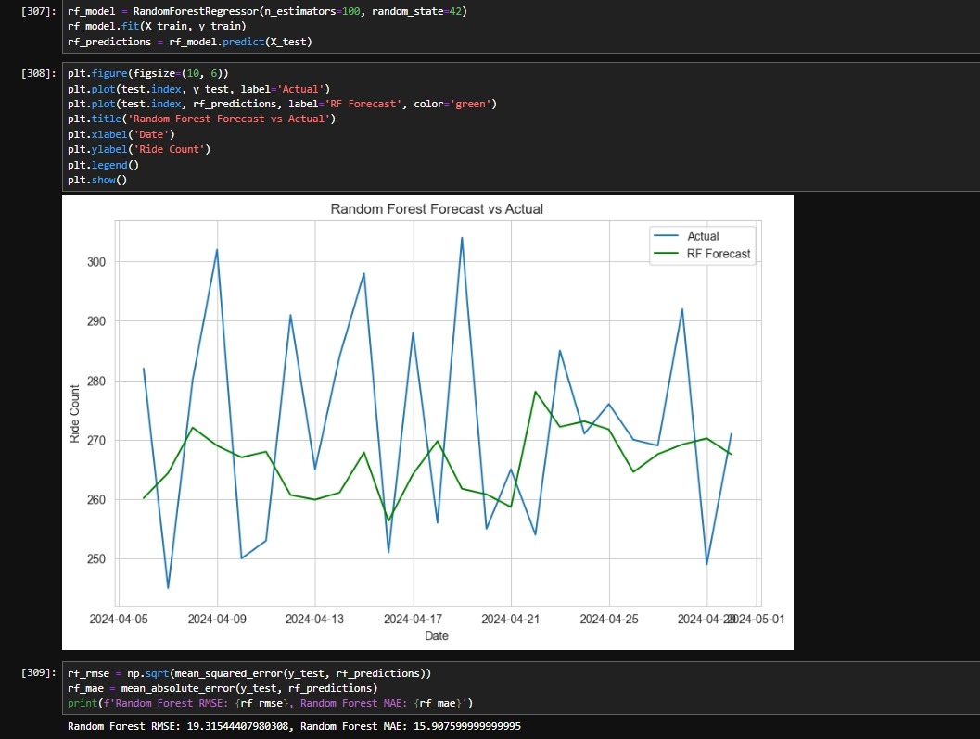

Slide 18
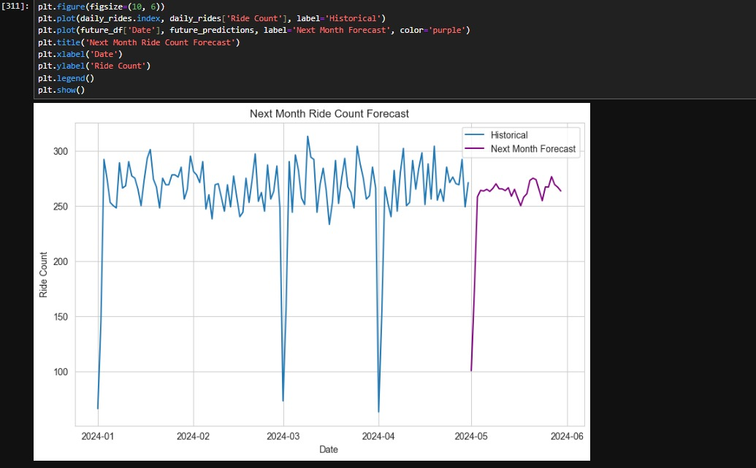

Slide 19



4
Data modeling

Slide 20
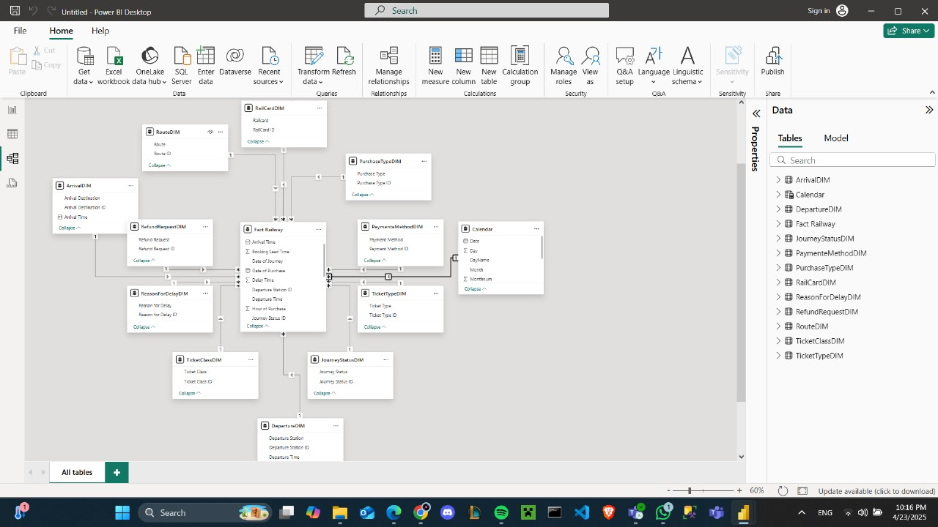

Slide 21
5
Data visualization

Slide 22
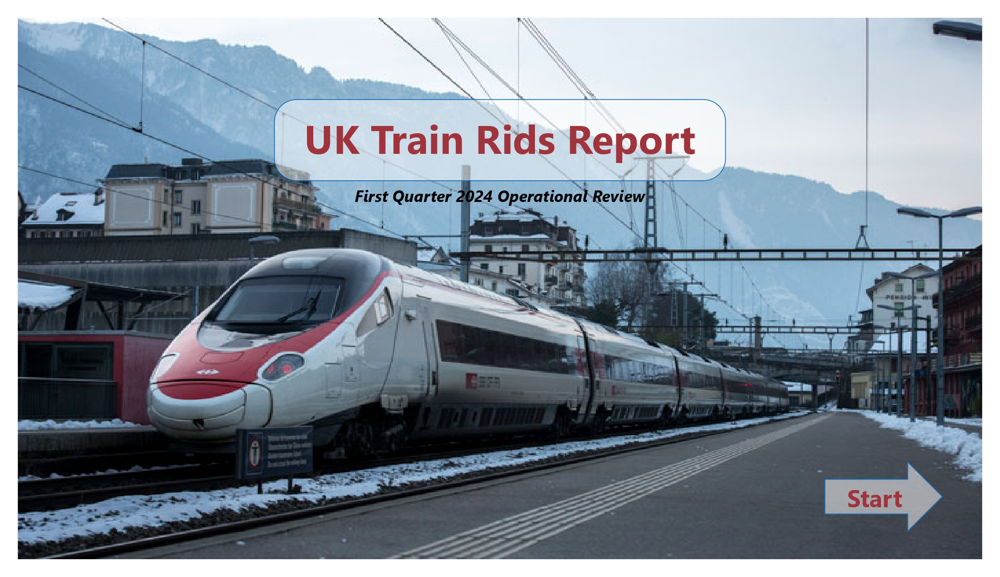

Slide 23
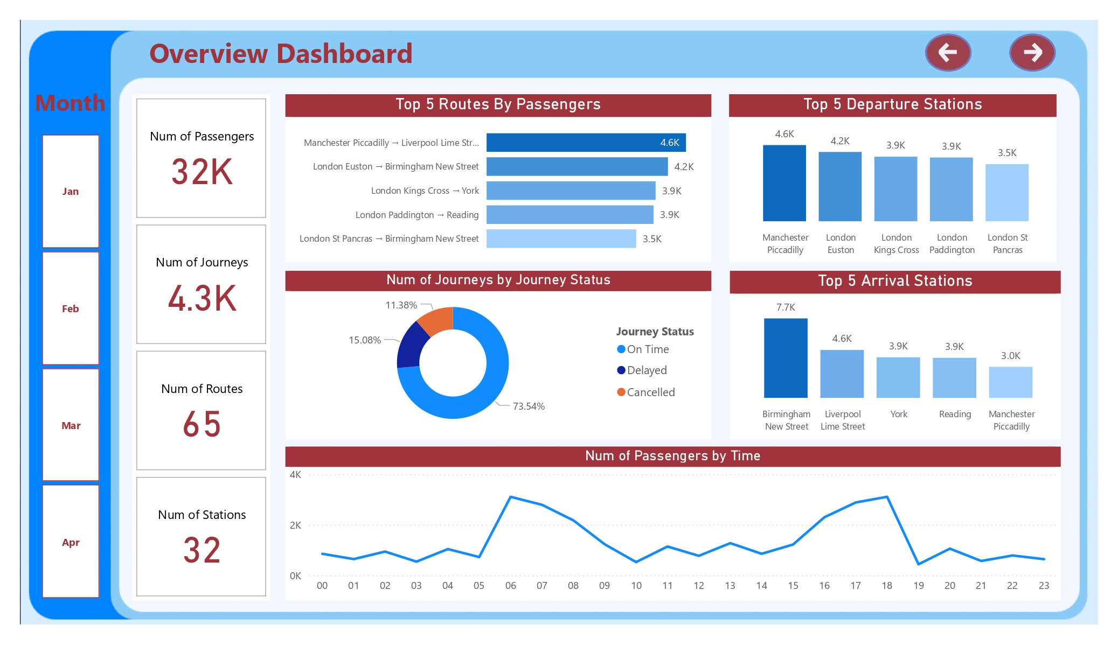

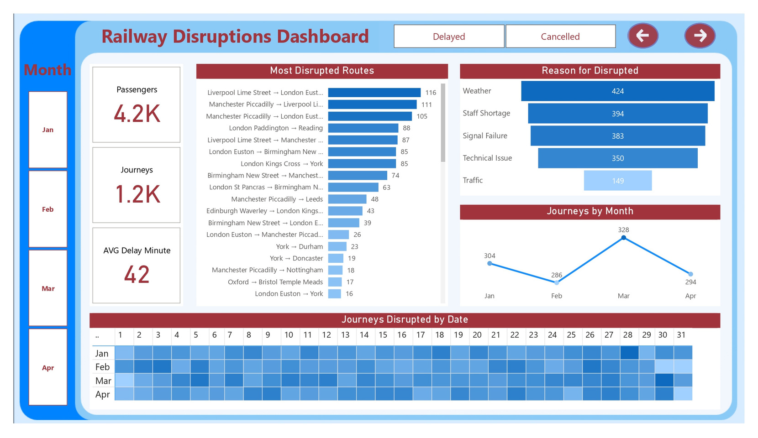

Slide 24
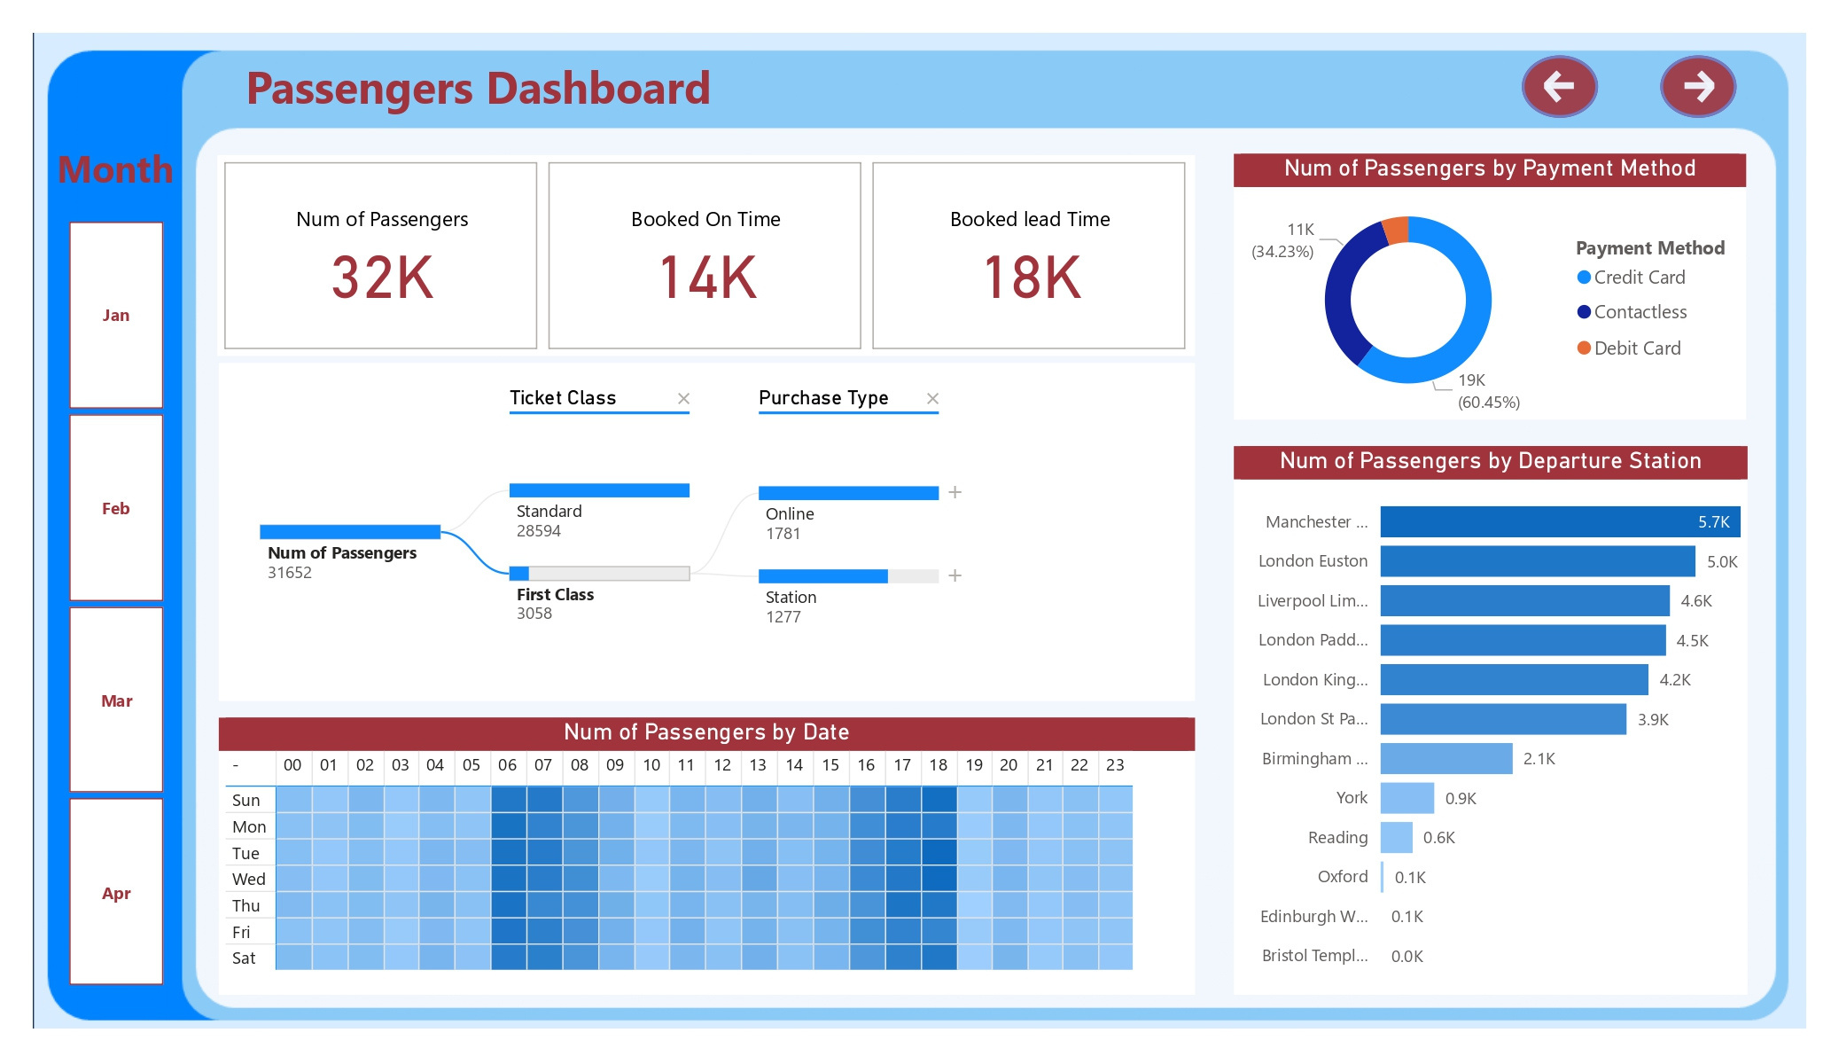

Slide 25
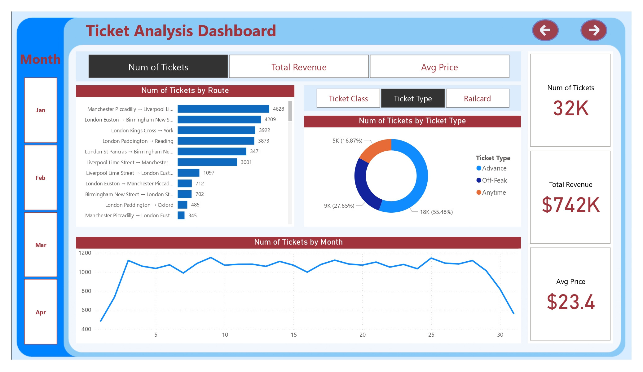

Slide 26


Slide 27
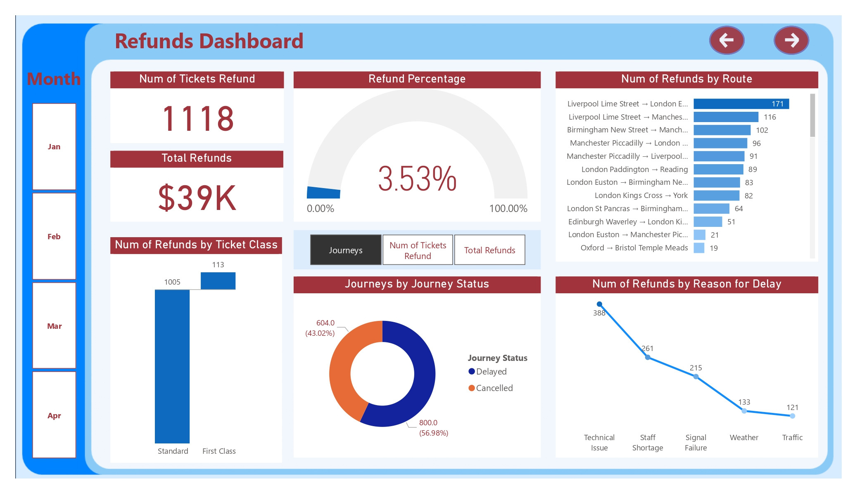

Slide 28
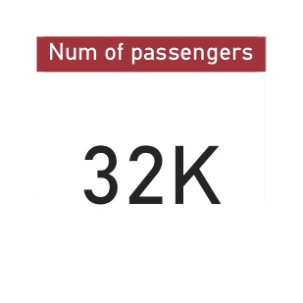
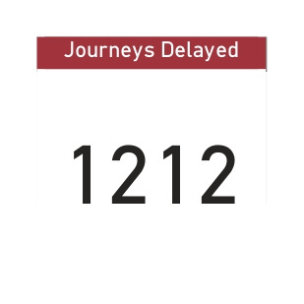

Slide 29
📊 Key Insights (Assumed from Analysis)
High Frequency of Delays During Peak Hours
Significant delays between 7–9 AM and 5–7 PM due to commuter traffic.
Certain Routes Have Recurring Delay Patterns
Lines passing through high-density urban stations showed above-average delay times.
Weekend Service is Less Frequent but More Reliable
Trains on weekends ran on time more often, but overall service was lower in volume.
Weather & Maintenance Issues Spike Delays
Analysis showed spikes in delays aligned with bad weather reports or planned maintenance periods.
Mid-week (Tues–Thurs) Has the Highest Volume of Train Usage
Passenger demand peaked mid-week, correlating with higher service strain.

Slide 30
✅ Recommendations Based on Insights
1. Dynamic Peak Scheduling
Add more trains during 7–9 AM & 5–7 PM
Use high-capacity trains on busy routes
2. Targeted Maintenance
Focus repairs on routes with frequent delays
Schedule night maintenance to avoid disruptions
3. Predictive Resource Allocation
Use AI models to forecast delays
Pre-position staff and repair teams accordingly
4. Passenger Communication
Launch real-time delay alerts via apps/displays
Show AI-based delay forecasts at stations
5. Efficient Weekend Operations
Match train availability to actual weekend demand
Use smaller trains or optimize scheduling
6. Weather-Based Monitoring
Integrate weather data into planning
Perform early inspections before bad weather

Slide 31


Thank You!

